Slide 1
Standard Operating Procedure (SOPs) Monitoring and Supervisory System
Workshop on Monitoring and Supervisory System
Department of Health, August September 12-13, 2019
Dr. Arshad Mahmood
Director M&E
Integrated Health Systems & Service Delivery Activity

Slide 2
Contents
Pre-requisites for SOPs of monitoring and supervision
Identification of health managers team for Monitoring and Supervision
Preparation of field visit plan
Conducting M&S visit
Reporting and providing Feedback

Slide 3
Pre-requisites for SOPs of monitoring and supervision
Dedicated health manager with the technical skills, knowledge and motivation to improve the quality of services;
Availability of monitoring tools, guidelines and protocols;
Resources required for monitoring and supervision (vehicle, POL, etc.)

Slide 4
Core Competencies of a Supervisor
Conceptual skills:
Ability to listen, probe and analyze situations, problems and formulate solutions;
Sufficient knowledge about health services and health system;
Interpersonal communication skills;
Ability to coach, train and convey information to others and learn from them;

Slide 5
..Core Competencies of a Supervisor
Sufficient knowledge of concepts of quality improvement (QI) including supportive supervision and the use of provincial guidelines and SOPs;
Ability to collect, analyze, visualize, interpret and provide feedback information/data
Deep understanding of the roles and responsibilities of supervisors
Ability to provide and receive feedbacks after each visit and write reports.

Slide 6
Potential Supervisors Team – District Level
District Health Officer
Deputy/Assistant District Health Officers
District DHIS Coordinator
Program Focal Persons of MNCH, LHW, EPI, Nutrition, TB, Malaria, Hepatitis, etc.
Any other position with special assignments such as, principal/ instructors of Nursing/public health schools

Slide 7
Potential Supervisors Team – Provincial Level
Director General Health Services
In-charge M&E Cell
Additional Secretary Technical/ Public Health, DOH.
Provincial program heads and monitoring officers of MNCH, LHW, EPI, Nutrition, TB, Malaria, Hepatitis, etc.
Any other with special assignments such as, Director PHSA, principal/instructors of public health schools etc.

Slide 8
Preparation of field visit plan
All supervisors will develop field visit plans using online M&S system: selecting details where, when to go, what to do and what checklist to fill;
Approval of the plan by deputing Driver and vehicle;
DHO Administration facilitate the preparation of field visit;
Supervisors will Download relevant tools/ checklists, previous month’s performance report as well as previous field visit report from web based M&S Dashboard

Slide 9
Resources needed for monitoring and supervision
Reliable transport;
Adequate time for preparation, travel, field visit, reporting and follow-up activities;
Monitoring and supervisory tools; and
Support for periodic review meetings.

Slide 10
Conducting M&S visit
Show respect and patience throughout the supervisory visit;
Allow time for staff to complete any consultations underway;
Observe and gather information using the checklist as contained in tour plan;
The tool/checklist has to be filled completely according to the given user guidelines;
Mark evidence of your monitoring visit as per standing instructions, like marking the visit in the attendance register of the facility, or in the LHW, CMW registers etc.;
Review the previous action points and status of implementation;

Slide 11
……Conducting M&S visit
Listen to their problems and challenges;
Address and follow up on problem areas;
Provide corrective and supportive feedback on performance;
In case a procedure is performed incorrectly, demonstrate the correct procedure and ask for return demonstration;
Update supervisees on new guidelines and information if any;
Give on-the-job training on new techniques and approaches, if required;

Slide 12
Immediate feedback
Once you are done with supervision give your feedback;
Use positive feedback, when performance is good; and constructive feedback, and remember when performance needs improvement.
Start with those areas they are doing well followed by those where there are problems.
Focus on systems and processes, the performance or action, not on the person.
Discuss previous action points which were not implemented and include them in the new action plan;
Give a chance to the supervisee to respond.

Slide 13
Wrap up
Summarize the specific aspects that require improvement;
Identify persons responsible to solve the identified action points and problem areas;
Share with staff as a group the supervisor’s general impressions on what is going well and what needs further improvement;
When ready to leave, thank the supervisees and others.

Slide 14
Follow up and Feedback
Follow up on equipment and commodity supply problems in a timely manner with the district or provincial level authorities.
Give praise and recognition to health service providers for what they are doing right. Even if monetary recognition is not possible, recognition can be made in other forms. Health workers can be recognized through issuing appreciation letters or by awarding certificates for acknowledging good work.
Upload online the checklist within one week.

Slide 15
Standard Operating Procedures Monitoring & Supervisory System

Slide 16
District M&E Cells: Functions
Act as the relay point for consolidation of facility based data on monthly and quarterly basis, for the DHIS, LMIS and other program-based MISs;
M&E Cell members will prepare and follow monthly monitoring and supervisory plans of their respective domains of activity ;
M&E members will use specified monitoring tools/checklists;
M&E Cell members will submit reports to DHO and provide feedback to health facility in-charges;

Slide 17
…..District M&E Cells: Functions
Collect data for all MIS and enter into the online MIS for all programs including lady health workers (LHWs)
Coordinate and maintain records of supervisory visits of all the vertical programs and update M&E Dashboard on monthly basis;
Report to DHO and provide feedback to vertical programs;
Prepare presentations on the DOH performance for DHPMT, provide feedback and guidance to enhance their capacity for improving their performance;
Support facilities in identifying problems, taking decisions, and implementing them at the district level;

Slide 18
…..District M&E Cells: Functions
Report to DHO and put forward issues to DGHS Sindh for taking decisions and their implementation;
Monitor the overall progress of the District Action Plans (DAPs) implementation and service delivery;
Build capacity of facility in-charge/staff for recording and reporting on DHIS and other MIS of vertical programs;
Act as contact point for data acquisition for all stakeholders and development partners.
Monitor implementation of Sindh Health Sector Strategy by collecting, compiling, and producing reports in coordination with other stakeholders;

Slide 19
Types of Health Indicators
INPUTS AND PROCESSES
OUTPUTS
OUTCOMES
IMPACT
Availability of drugs per care level
Basic equipment per activity type
Number of staff per category and per capita
Number of drug shortages
Number of surgical or obstetrical acts done
Number of children immunized
Number of new cases in the facilities
Hospital bed occupation rate
Full immunization rate interventions
Incidence and prevalence of certain diseases, such as HIV, malaria, TB
Number of TB cases detected
Life expectancy at birth
Infant mortality
Prevalence of malnourished children under 5
Source: Adapted from WHO. Global reference list of 100 core health indicators. Retrieved from http://www.who.int/healthinfo/indicators/2015/en/.
Notes:
The general concept of health can be construed broadly to encompass indicators of all measurable aspects of health and the health sector.
The World Heath Organization’s Monitoring, Evaluation and Review framework organizes health indicators in four components. Within each component, categories of indicators are defined that allow the measurement of health at many levels:
Indicators of inputs and processes are broad, affecting many other parts of the health sector.
Indicators that fall under outputs and outcomes tend to be quite specific to a particular health topic, and may respond quickly to changes and progress in the health sector.
Impact indicators, which are slower to respond to policy, program, and practice changes, are important to provide a snapshot of the health of a population.
The components of the monitoring, evaluation, and review framework can also be loosely linked to the type of data that are used.
Outcomes and impact indicators tend to be calculated using individual- or household-level data.
Inputs and processes or outputs are often calculated using subnational-level data.
Certain inputs and processes indicators, such as total health expenditure, are calculated at the national level.

Slide 20
EXAMPLE: Indicators for Reproductive, Maternal, and Child Health Monitoring
INPUTS AND PROCESSES
OUTPUTS
OUTCOMES
IMPACT
Health financing
expenditure per target population (children, women, etc.)
General government
expenditure on health as a percentage of general government expenditure
Health workforce
midwives, per 10 000 population
Governance
presence of key policies to promote maternal and child health
Information
births registered
deaths registered (with cause)
Service access and readiness
facilities that offer and meet tracer criteria for basic and comprehensive obstetric care, per 10 000 pregnant women
caesarean section rate in rural populations
facilities that offer and meet tracer criteria for child health services, per 1000 children
Coverage of interventions
antenatal care
births attended by skilled health personnel
immunization coverage
family planning needs satisfied
children with diarrhea receiving oral rehydration therapy
children with fever receiving antimalarials
insecticide-treated bednet use
antiretroviral prophylaxis among HIV-positive pregnant women
vitamin A supplementation among children
postnatal care
Risk factors and behaviours
contraceptive prevalence
access to safe water
access to improved sanitation
low birth weight among newborns
early initiation of breastfeeding
children who are stunted or underweight
Health status
under-5 mortality
maternal mortality ratio
child mortality by major cause of death, by sex and age
Financial risk protection
out-of-pocket payments as a percentage of total health expenditure
Source: Adapted from Monitoring, evaluation and review of national health strategies: a country-led platform for information and accountability. Geneva, World Health Organization, 2011.
Notes:
This is an example of a package of health indicators for reproductive, maternal, and child health monitoring. To represent this broad health topic, indicators were chosen from all components of the monitoring, evaluation, and review framework. Typically, the best indicators of progress in a priority health topic are those that are identified by countries rather than imposed from outside sources; indicators selected by a country may be of greater relevance to the needs of that country.
Note that the general approach to monitoring health will be the same regardless of the health indicators that are selected.

Slide 21
Quality of Health Services

Slide 22
Quality of Health care
Quality health care can be simply defined as doing the right thing (getting the health care services you need), at the right time (when you need it), in the right way (using the appropriate test or procedure), to achieve the best possible results.

Slide 23
Health care quality can be defined by six attributes:
Safety - patients should not be harmed by the care that is intended to help them
Patient-Centered - care should be based on individual needs
Timely - waits and delays in care should be reduced
Effective - care should be evidence-based
Efficient - reduce waste
Equitable - care should be equal for all people

Slide 24
Continuous Quality Improvement (CQI)
CQI is a cyclical process.
It involves identifying an area where there is an opportunity for improvement then outline the sequence of activities that should occur in order to solve that problem, and implementing them.
Once the cycle is completed it has to be determined whether the problem has been solved.
If the problem continues, the cycle should be repeated.

Slide 25
Continuous Quality Improvement Cycle (CQIC)
There are seven steps involved in implementing CQI cycle:
Step 1→ identify an area where opportunities for improvement exists.
Step 2→ define a problem within that area, and outline the sequence of activities (the process) that should occur in that problem area.
Step 3→ establish the desired outcomes of the process and the requirements needed to achieve them.

Slide 26
Continuous Quality Improvement Cycle (CQIC) cont.
Step 4→ select specific steps in the process, and for each step list the factors that prevent the achievement of desired outcome.
Step 5→ collect and analyze data about the factors that are preventing the achievement of the desired outcomes of the desired steps.
Step 6→ take corrective action to improve the process.
Step 7→ monitor the results of the action taken

Slide 27
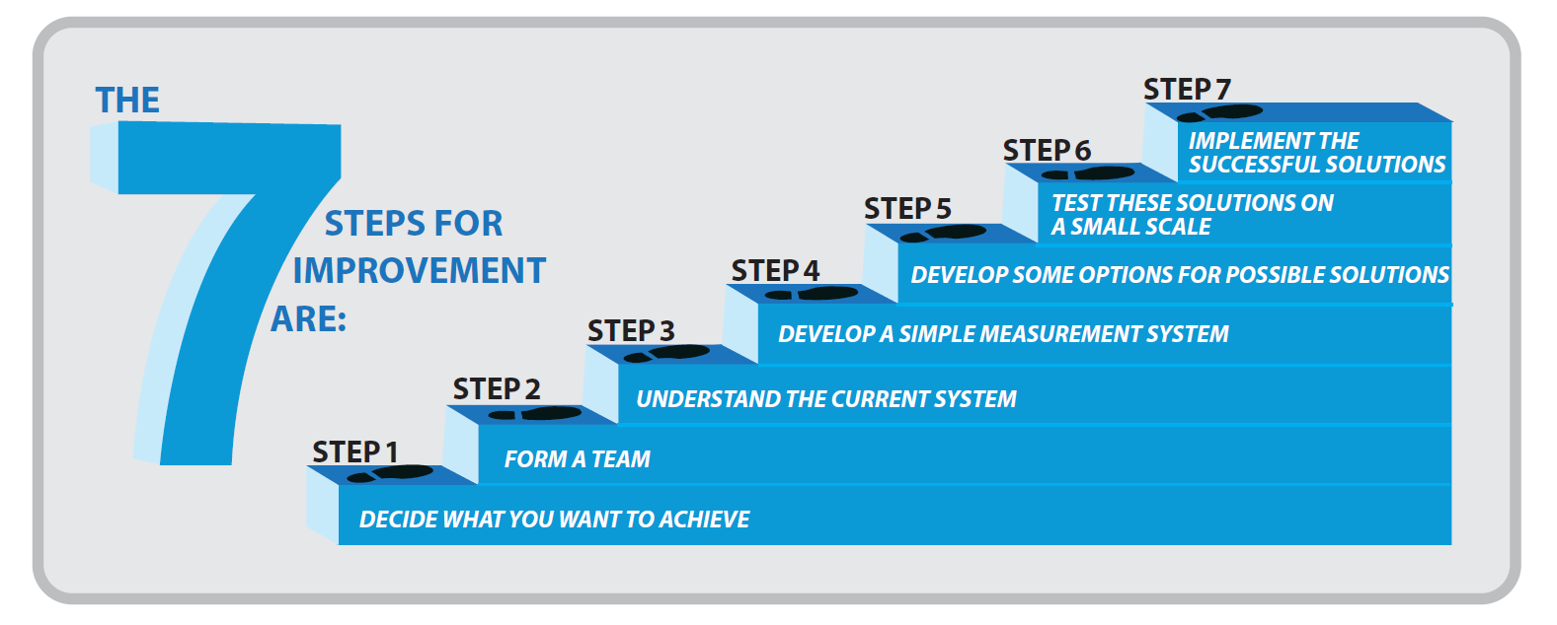
Improving Quality in Healthcare

Slide 28
Thank You
The Integrated Health Systems Strengthening and Service Delivery (IHSS-SD) Activity is funded by the United States Agency for International Development and implemented by JSI Research &Training Institute, Inc. with its consortium partners - Jhpiego, Rural Support Program Network & Contech International.

